Slide 1
Python in Data Science Introduction & Numpy

Slide 2
Objective
We explore the libraries most often used in Data Science for real analytical work.
Analyzing — compute statistics and summaries over large datasets.
Cleaning — handle missing values, wrong types, and messy rows.
Exploring — slice, filter, and group data to find patterns.
Manipulating — reshape, combine, and derive new columns.

Slide 3

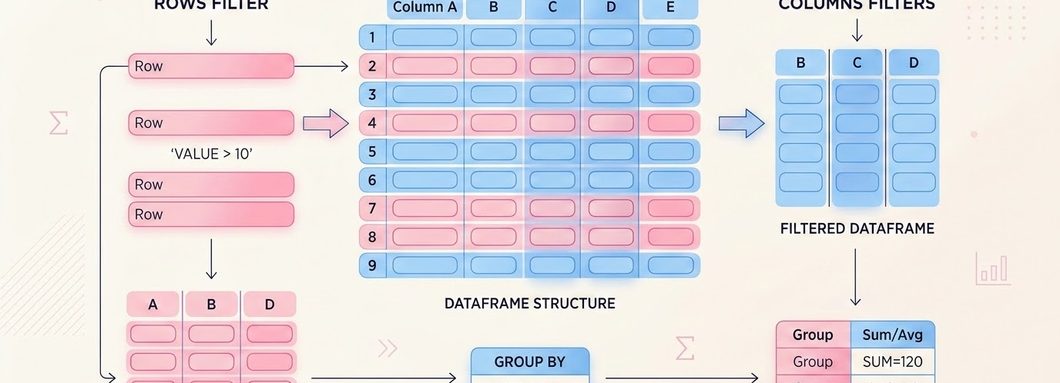
CORE LIBRARIES FOR DATA MANIPULATION IN PYTHON
Introduction to NumPy & Pandas
01
NumPy
02
Pandas
NUMERICAL PYTHON
DATA ANALYSIS & MANIPULATION
• The fundamental package for scientific computing in Python.
• Provides high-performance N-dimensional array objects (ndarray).
• Offers fast vectorized operations, linear algebra, and random number generation.
• Built on top of NumPy for powerful data analysis and manipulation.
• Introduces intuitive DataFrame and Series data structures.
• Essential for cleaning, transforming, aggregating, and analyzing structured data.

Slide 4
Python in Data Science:
Numpy

Slide 5
NumPy Facts
AT A GLANCE
2005
BSD
Python / C
600M+ / yr
First released — now the backbone of the scientific Python stack.
Permissive open-source license, free for commercial use.
Python interface with a C core for near-native speed.
Downloads per year — one of Python's most-used packages.

Slide 6
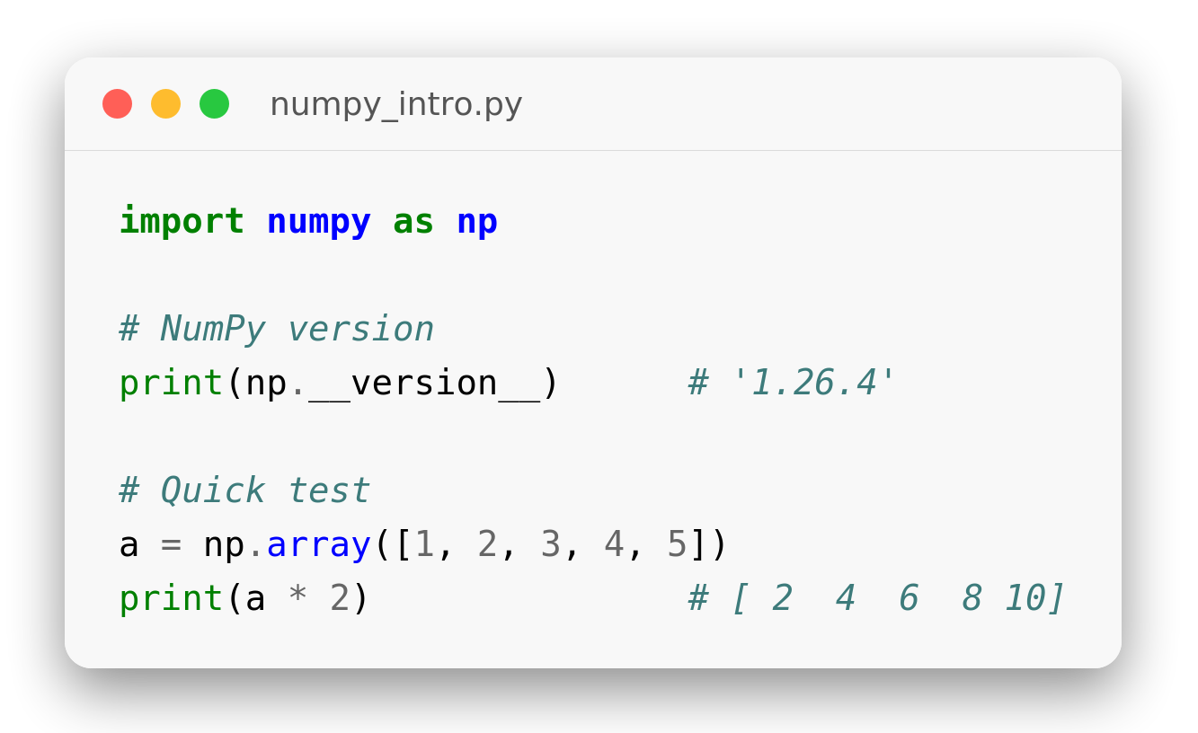
Why NumPy
The fundamental array library
NumPy gives fast, multi-dimensional array objects plus math tools.
Foundation of SciPy, Pandas, Matplotlib, scikit-learn.
Up to 100× faster than native Python lists.
Vectorized operations — no slow Python for-loops.
Memory-efficient: C-contiguous typed arrays.
Notes:
import numpy as np
# NumPy version
print(np.__version__) # '1.26.4'
# Quick test
a = np.array([1, 2, 3, 4, 5])
print(a * 2) # [ 2 4 6 8 10]

Slide 7
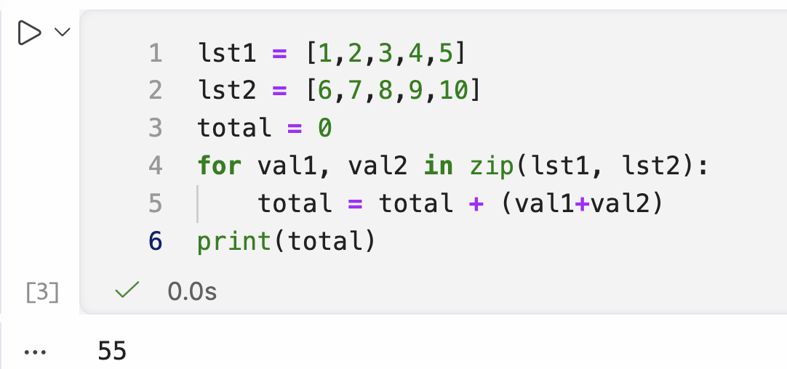
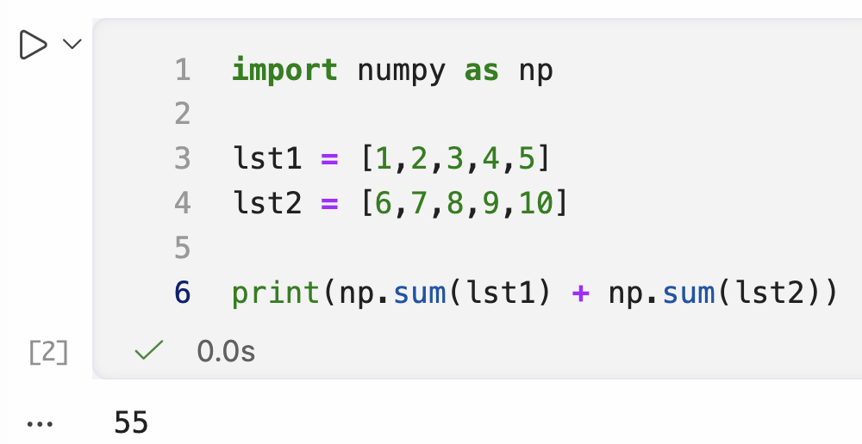
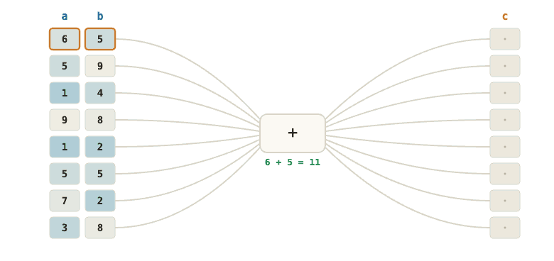
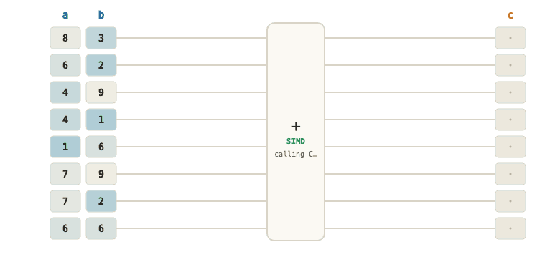
Python Loop
Python Numpy
High control — you decide exactly what happens at each step
Up to ~100× faster — operations run in optimized C language, working on the whole array at once rather than step-by-step.

Slide 8
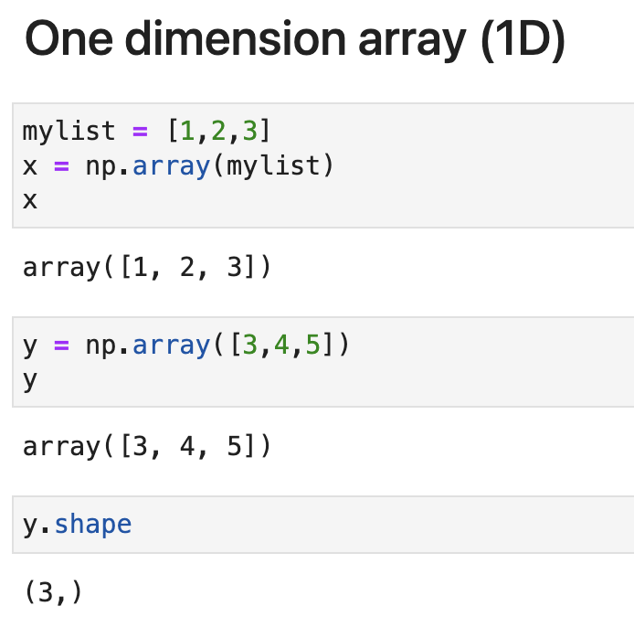
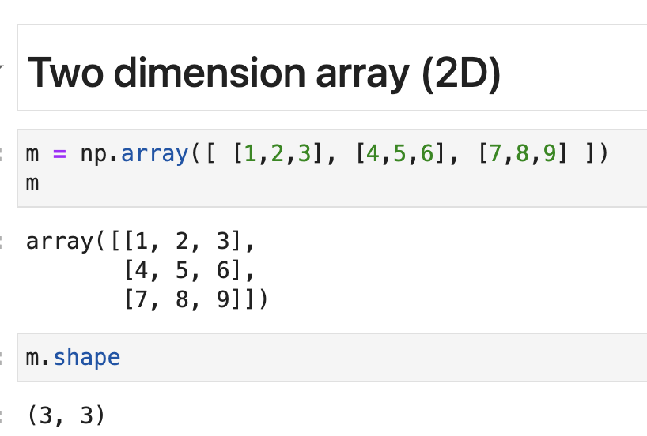
Create 1D Array
Create 2D Array

Slide 9
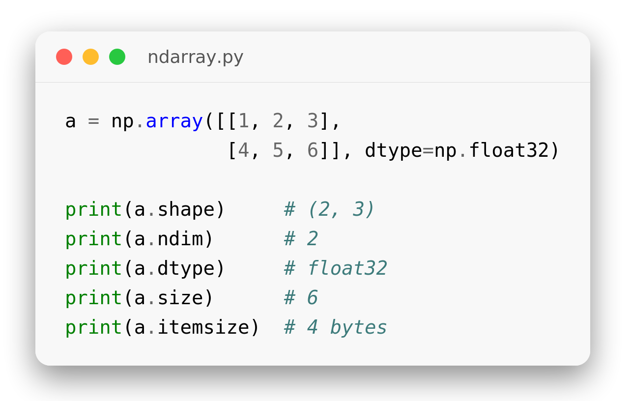
The ndarray
One typed, fixed-size object
.shape — tuple of dimensions, e.g. (2, 3).
.dtype — element type, e.g. float32, int64.
.ndim — number of axes;
.size — total elements.
.itemsize — bytes per element;
Notes:
a = np.array([[1, 2, 3],
[4, 5, 6]], dtype=np.float32)
print(a.shape) # (2, 3)
print(a.ndim) # 2
print(a.dtype) # float32
print(a.size) # 6
print(a.itemsize) # 4 bytes

Slide 10
Numpy - Operations

Slide 11
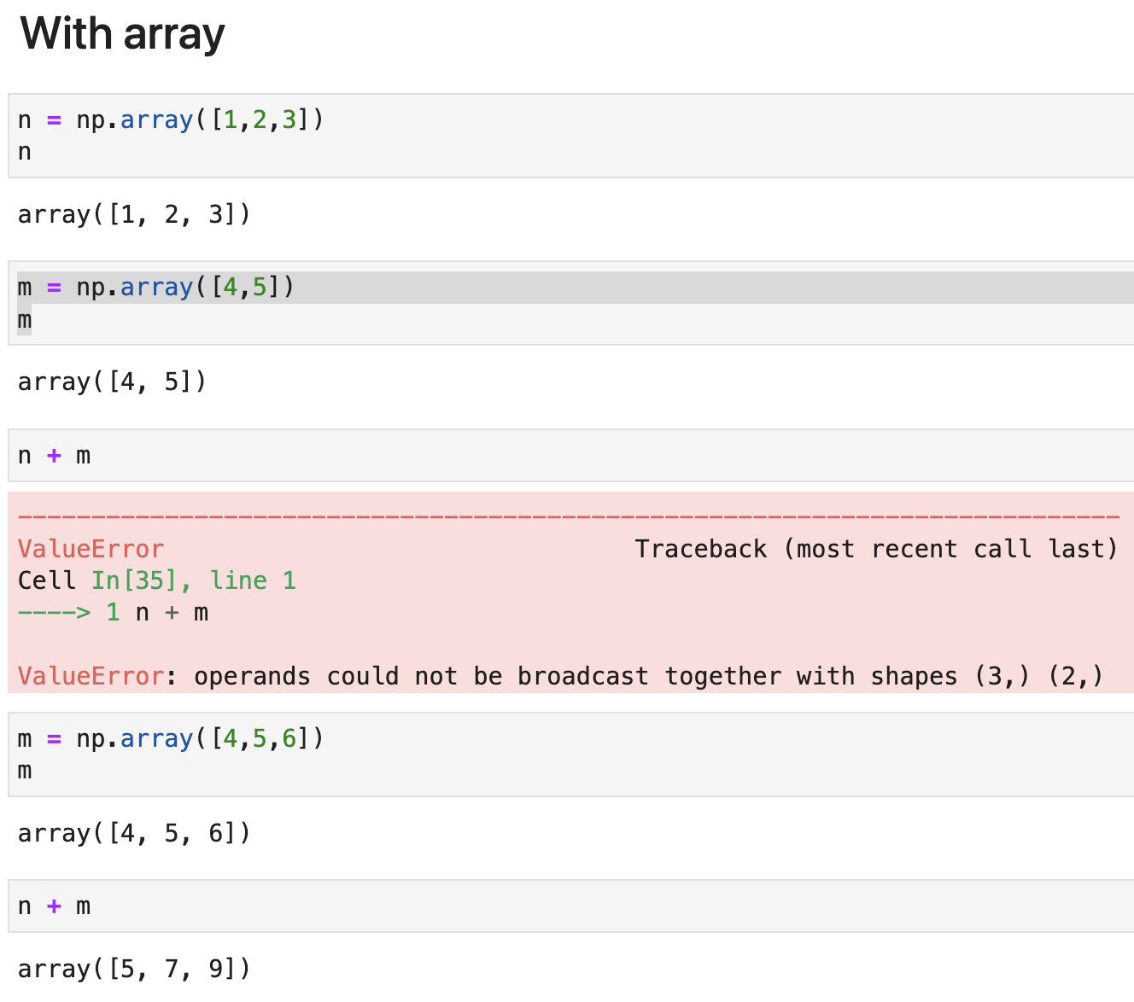
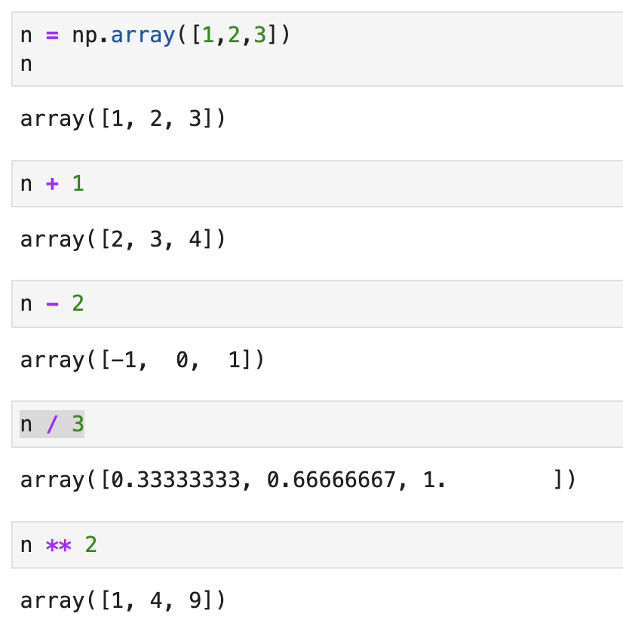
Operation with Scalar (Number)
Operation with numpy array
Numpy are element-wise using operators (+ * /)
The element size of both operands must be equal

Slide 12
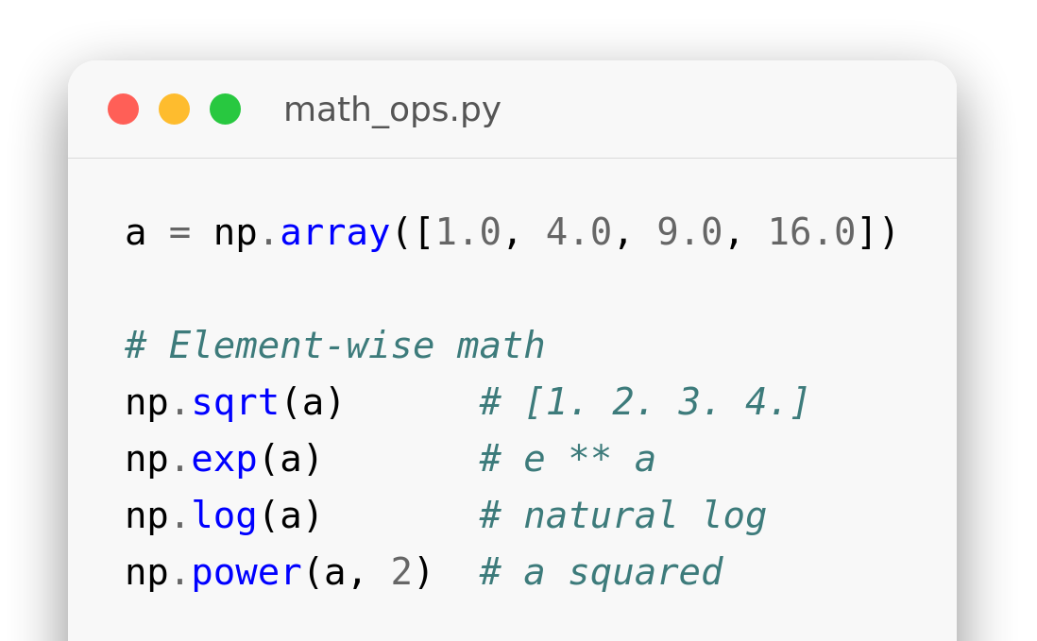
Math Functions
Vectorized math
np.sqrt / exp / log apply element-wise across the array.
np.power(a, 2) squares every element.
Trig helpers: np.sin / cos / tan.
Notes:
a = np.array([1.0, 4.0, 9.0, 16.0])
# Element-wise math
np.sqrt(a) # [1. 2. 3. 4.]
np.exp(a) # e ** a
np.log(a) # natural log
np.power(a, 2) # a squared

Slide 13
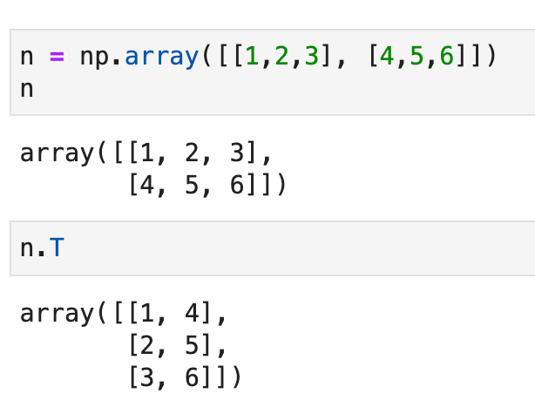
Transpose
Array Transposition
.T flips an array over its diagonal, swapping rows and columns.
Converts a matrix of shape (2, 3) into shape (3, 2).
Returns a view of the original array without copying memory.

Slide 14
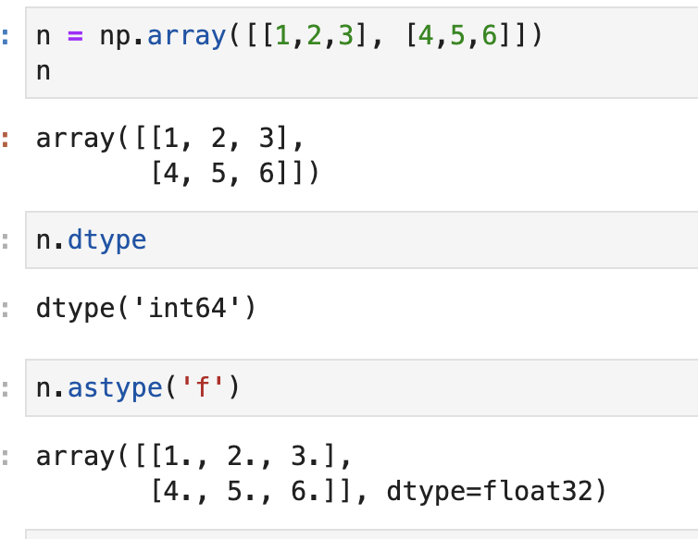
Cast between types
NumPy Type Casting
.astype() explicitly converts a NumPy array from one data type to another.
Supported NumPy types include int64, float32/64, bool, and string shorthand like 'f'.
Casting returns a new copy of the array with the target dtype.

Slide 15
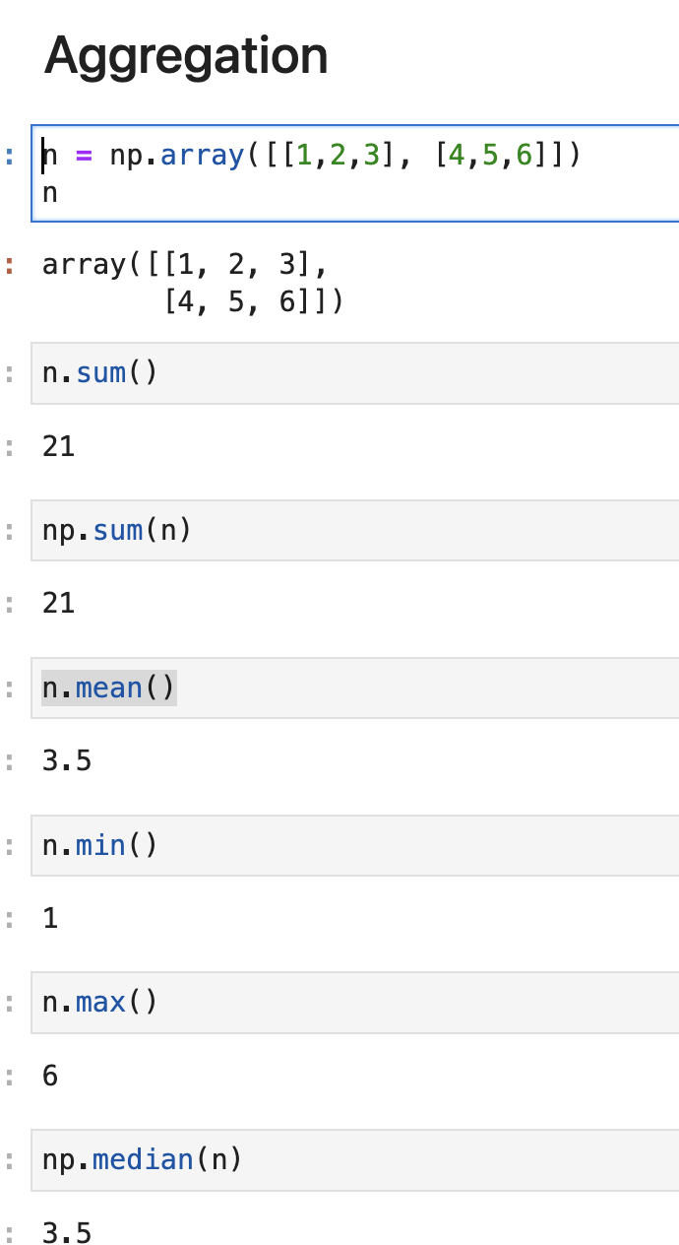
Aggregation
Array Aggregations
Aggregations summarize array data into single statistics (e.g. sum, mean, min, max).
Can be called as array methods (.sum()) or top-level functions (np.sum()).
Perform fast calculations across all elements or along specified axes.

Slide 16
Indexing and Slicing

Slide 17
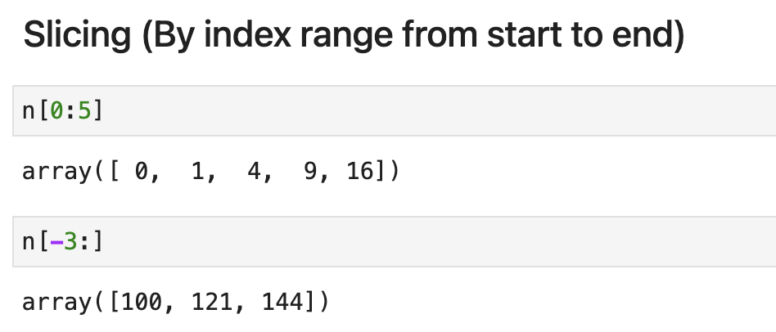
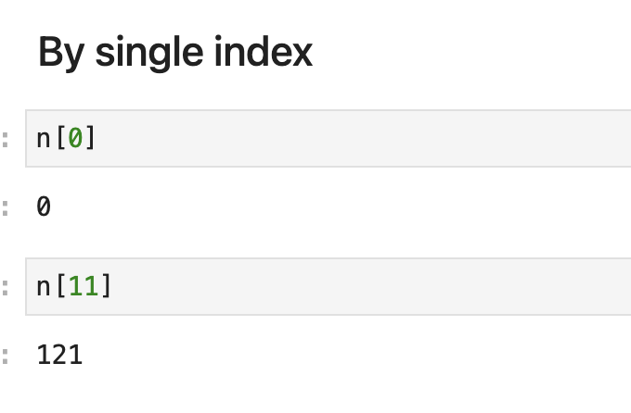
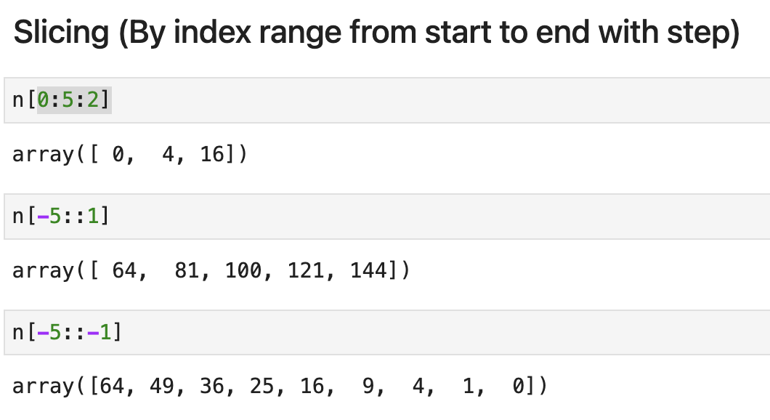
Indexing and Slicing

Slide 18
NumPy Practice
Exercises

Slide 19
Lists Into Arrays
1
List to Array
2
Vector Dimensions
Convert a plain Python list into an ndarray
Check the dimensions of y = [3, 4, 5]
mylist = [1, 2, 3]
x = np.___(mylist)
print(x)
y = np.array([3, 4, 5])
print(y.___)
Expected output:
Expected output:
[1] → [1 2 3]
[1] → (3,)

Slide 20
Operations & Math
SECTION 2 OF 5 · LESSON 1.1
Vectorized arithmetic with scalars and arrays, broadcasting, element-wise math functions, transpose, casting, and aggregation.

Slide 21
Scalar Arithmetic
1
Add & Subtract
2
Divide & Raise a Power
For n = [1, 2, 3], add 1
and subtract 2, element-wise
For the same n, divide by 3
and square every element
n = np.array([1, 2, 3])
print(n ___ 1)
print(n ___ 2)
# hint: the same operators
# you'd use on plain numbers
n = np.array([1, 2, 3])
print(n ___ 3)
print(n ___ 2)
# hint: one splits values into
# thirds, the other raises a power
Expected output:
Expected output:
[1] → [2 3 4]
[2] → [-1 0 1]
[1] → [0.33333333 0.66666667 1. ]
[2] → [1 4 9]
Notes:
# Exercise 1 — Add & Subtract
n = np.array([1, 2, 3])
print(n + 1)
print(n - 2)
# Exercise 2 — Divide & Raise a Power
n = np.array([1, 2, 3])
print(n / 3)
print(n ** 2)

Slide 22
Transpose & Type
7
Transpose a Matrix
8
Inspect & Convert Type
For n = [[1,2,3],[4,5,6]],
flip its rows and columns
For n = [[1,2,3],[4,5,6]], print its stored type,
then convert it to float32
n = np.array([[1, 2, 3],
[4, 5, 6]])
print(n.___)
# hint: a one-letter attribute,
# no parentheses needed
n = np.array([[1, 2, 3],
[4, 5, 6]])
print(n.___)
print(n.___(___))
# hint: one just reports the type,
# the other returns a converted copy of that type
Expected output:
Expected output:
[[1 4]
[2 5]
[3 6]]
[1] → int64
[2] → [[1. 2. 3.]
[3] → [4. 5. 6.]]
Notes:
# Exercise 7 — Transpose a Matrix
n = np.array([[1, 2, 3],
[4, 5, 6]])
print(n.T)
# Exercise 8 — Inspect & Convert Type
n = np.array([[1, 2, 3],
[4, 5, 6]])
print(n.dtype)
print(n.astype('f'))

Slide 23
Totals & Stats
9
Total It Two Ways
10
Four Quick Stats
For the same n, add up all its values using both call styles
For the same n, compute its average, min, max, and middle value
n = np.array([[1, 2, 3],
[4, 5, 6]])
print(n.___())
print(np.___(n))
# hint: same operation, once as a
# method and once as a function
n = np.array([[1, 2, 3],
[4, 5, 6]])
print(n.___(), n.___(),
n.___(), np.___(n))
# hint: four stats in one line -
# avg, smallest, largest, mid-point
Expected output:
Expected output:
[1] → 21
[2] → 21
[1] → 3.5 1 6 3.5
Notes:
# Exercise 9 — Total It Two Ways
n = np.array([[1, 2, 3],
[4, 5, 6]])
print(n.sum())
print(np.sum(n))
# Exercise 10 — Four Quick Stats
n = np.array([[1, 2, 3],
[4, 5, 6]])
print(n.mean(), n.min(),
n.max(), np.median(n))

Slide 24
Indexing & Slicing
SECTION 3 OF 5 · LESSON 1.2
Pulling values out of an array by single index, and slicing ranges from the front, back, and with a step.

Slide 25
Single-Index Lookups
1
First Element
2
A Later Element
Get the value at first element
Get the value at 2nd row, 2nd column
n = np.array([0, 1, 4, 9, 16, 25, 36, 49, 64, 81, 100, 121, 144])
print(n[___])
n = np.array([
[0, 1],
[ 4, 9]
])
print(n[___])
Expected output:
Expected output:
[1] → 0
[1] → 9
Notes:
# Exercise 1 — First Element
n = np.arange(13) ** 2
print(n[0])
# Exercise 2 — A Later Element
n = np.arange(13) ** 2
print(n[11])

